Slide 1

Department of Computer Science and Engineering
Mini Project Phase Presentation
Course Code: 21CSMP67
PROJECT TITLE
Driver-Drowsiness Detection
VISVESVARAYA TECHNOLOGICAL UNIVERSITY - BELAGAVI
Accredited by NBA
Students Name:
Ms. Annapurna Lingadalli (2BU21CS018)
Ms: Anuli Malalikar (2BU21CS019)
Ms. Tanvi Manish Kolhapuri (2BU21CS168)
Ms: Shreya Basavaraj Itnal (2BU21CS136)
Guide Name:
Name: Prof. Abhinanandan M
Designation: Professor

Slide 2
Outline
Introduction
Literature Review
Problem statement
Objectives
Requirement Specification
Architecture Diagram
Design modules
Results
Outcomes
Conclusion and future enhancement
Bibliography

Slide 3
Introduction
Driver drowsiness detection systems are designed to prevent accidents caused by driver fatigue. These systems use advanced technologies to monitor a driver's alertness and detect early signs of drowsiness.
By analyzing various physiological and behavioral indicators, such as eye movements, blink patterns, head position, and steering behavior, these systems can accurately assess a driver's level of fatigue.
When signs of drowsiness are detected, the system alerts the driver through visual, auditory, or haptic feedback, encouraging them to take a break or adopt measures to stay alert. This proactive approach significantly reduces the risk of accidents, enhancing road safety and protecting the lives of drivers, passengers, and other road users.

Slide 4
Literature Survey
S.NO | AUTHORS/YEAR | TITLE | OBSERVATIONS
1 | Elena magan, m.paz sesmero Year:2022 | Drowsiness detection by applying deep learning technique to sequence of images | Develop an ADAS to non-intrusively detect driver drowsiness and alert drivers to prevent accidents.
2 | S. S. Desai, A. N. Jadhav Year:2021 | A Review on Vision-Based Drowsiness Detection Methods for Driver Monitoring Systems | Various computer vision techniques such as eye tracking, head pose estimation, and facial expression analysis. Provides an overview of vision-based methods for detecting drowsiness, emphasizing their application in driver monitoring systems.
3 | A. F. M. Hani, M. H. Mansor, N. A. Ismail Year:2019 | Driver Drowsiness Detection Systems: A Review | Includes machine learning algorithms, image processing techniques, and physiological sensors Reviews different approaches and technologies used in driver drowsiness detection systems, discussing their effectiveness and challenges..
4 | M. Ali, H. Mahmud, M. M. Monowar Year:2020 | Driver Drowsiness Detection: A Review and a New Classification Model | Classification models integrating machine learning and signal processing techniques. Reviews existing methodologies and proposes a new classification model for driver drowsiness detection based on the reviewed approaches.

Slide 5
PROBLEM STATEMENTq
Driver drowsiness is a critical issue contributing to a significant number of traffic accidents worldwide.
Understanding the underlying causes of driver drowsiness is essential to developing effective prevention and detection strategies.
This problem statement aims to identify and analyze the various factors that contribute to driver drowsiness, thereby providing a foundation for targeted interventions.
The cause for driver drowsiness may include these factors Sleep Deprivation, Long Duration Driving, Environmental Factors.
To overcome such problem development and invention of modern technique like drowsiness detection system plays a vital role.
Which makes the driver alert by detecting the eye movement like closing of eyes or blinking eyes and thereby alerting the driver by buzzing alert sound.

Slide 6
Objectives
Accurate Detection of Drowsiness: Develop machine learning algorithms capable of analyzing physiological and behavioral indicators (e.g., eye closure rate, head nodding, blink duration).
Real-time Monitoring and Alerts: Develop and implement technologies to detect drowsiness in drivers and alert them in real-time.
Adaptability to Various Conditions: Ensure the system functions effectively under different driving conditions and environments.
User-friendly Design: Create an intuitive and easy-to-use system interface
Cost-effectiveness and Accessibility: Develop affordable solutions to make drowsiness detection systems widely accessible.

Slide 7
Requirement Specifications
Hardware Requirements:
Camera: Integrated webcam or external webcam capable of capturing high-quality video feeds.
Laptop: A laptop with adequate processing power (e.g., equipped with an RTX 3070 graphics card), SSD storage, and sufficient RAM for real-time video processing.
Internet Connectivity: Stable internet connection for cloud-based services (if applicable) or local network access.
Software Requirements:
Operating System: Compatible with Windows, macOS, or Linux distributions.
Python Environment: Python programming language (version 3.6 or higher) installed.
Libraries: Required libraries including OpenCV, Dlib, imutils, SciPy, pygame, win sound.

Slide 8
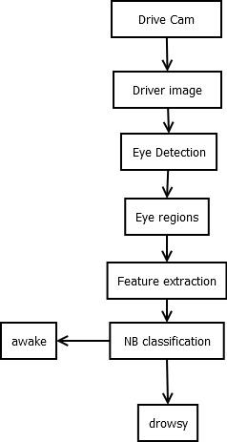
Architecture Diagram

Slide 9
Design Modules
OpenCV : provides pre-trained Haar cascades for eye detection, which can be used to detect eyes in real-time from video streams.
Dlib: provides facial landmark detection, which can be used to detect specific points on the face, including the eyes.
Scipy: it is used to calculate eye focus percentage using ecludien formula.
Imutils: It is a image and frame managing framework which is used for camera frame.

Slide 10
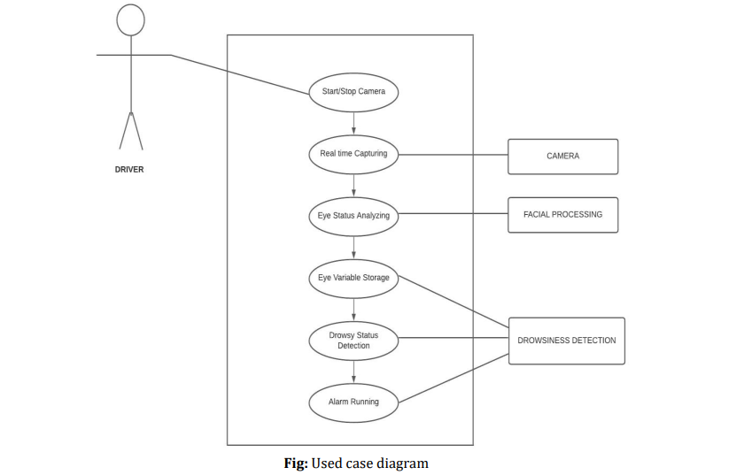
Use case Diagram

Slide 11
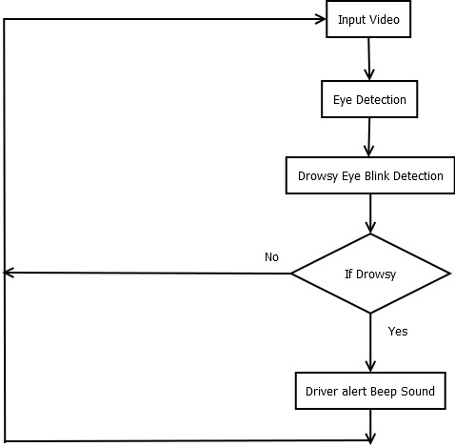
Work flow diagram :DFD

Slide 12
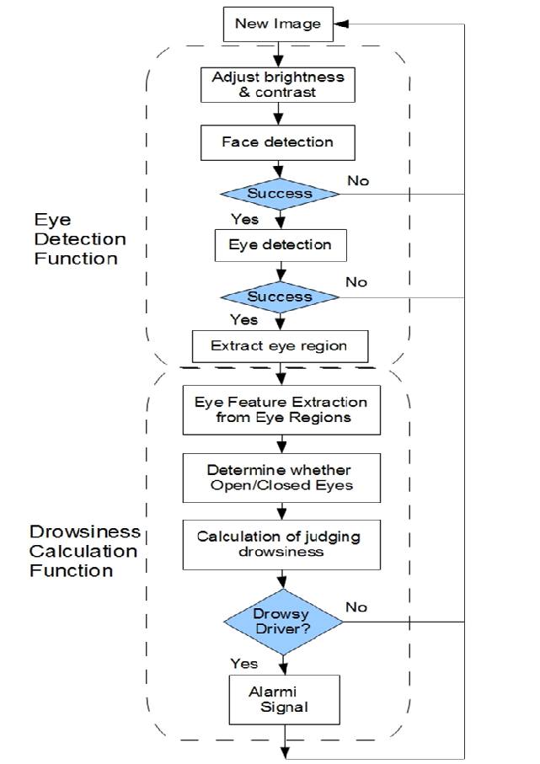
Activity Diagram:

Slide 13
Results
High Accuracy: Machine learning models often achieve accuracy rates above 90%.-
Improved Detection: ML models can learn and improve over time, offering better detection of subtle signs of drowsiness.-
Real-time Processing: Capable of providing immediate alerts to drivers.-
Reduced False Positives: Advanced algorithms reduce the number of false alerts by better distinguishing between drowsiness and other behaviors.-
Enhanced Personalization: Systems can adapt to individual driving patterns and physiological responses.

Slide 14
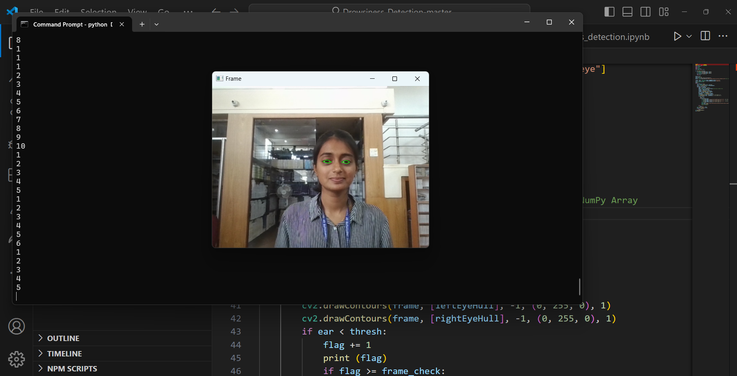
Outcomes Snapshots

Slide 15
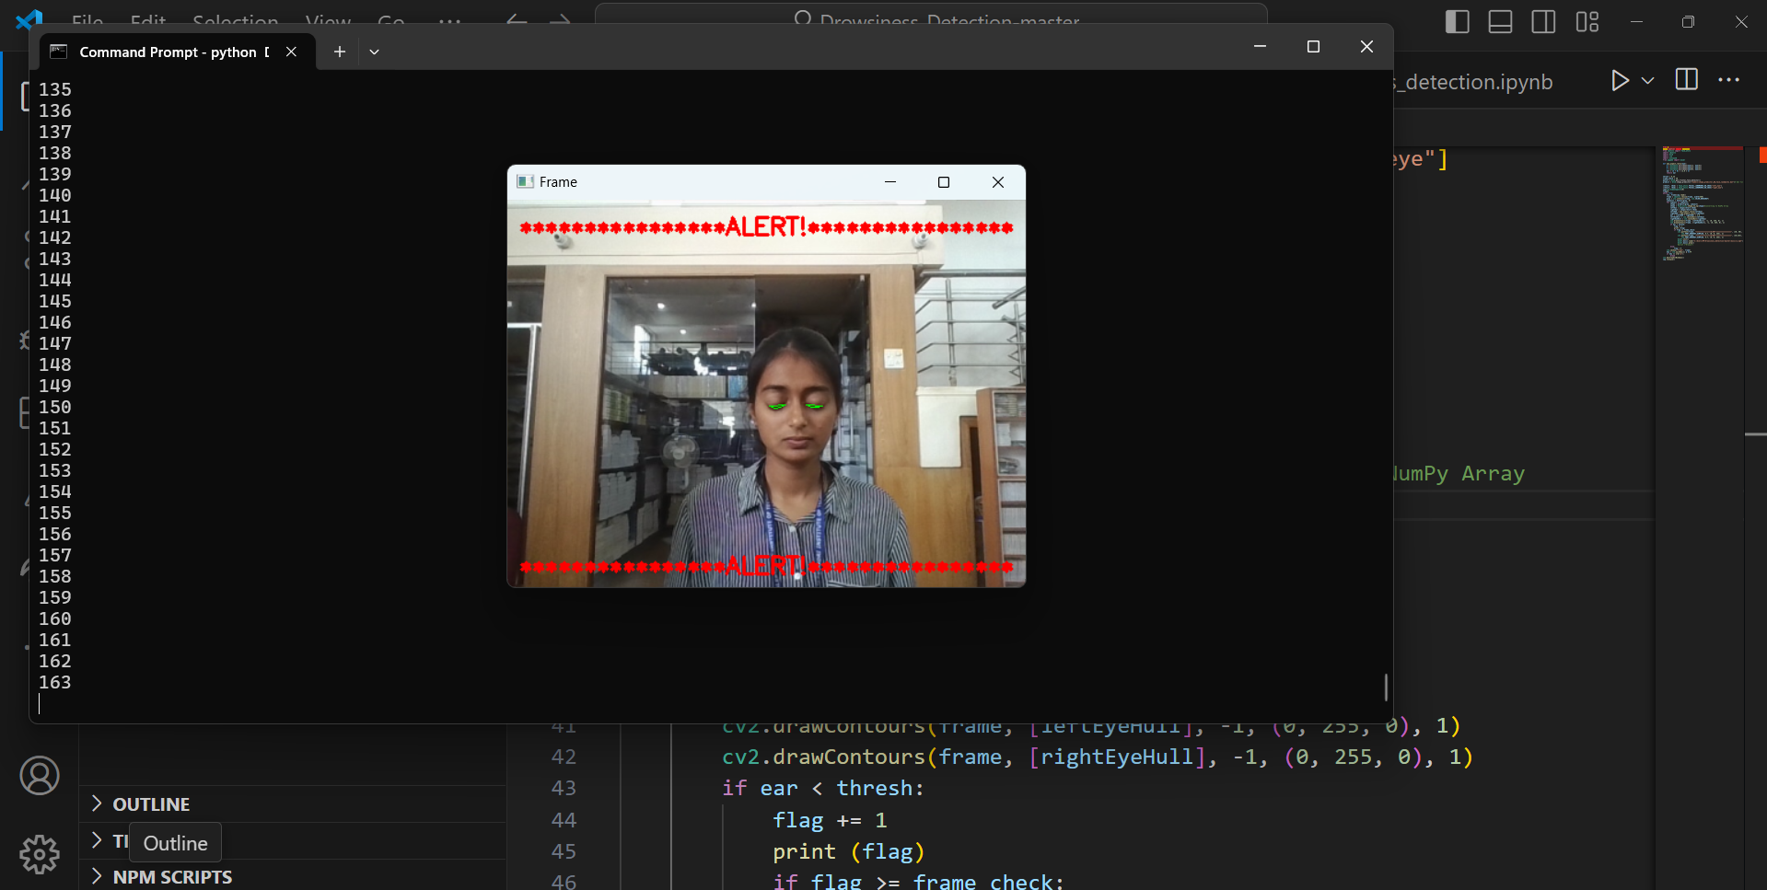

Slide 16
Conclusions
1. Effective Safety Enhancement: Drowsiness detection systems significantly enhance road safety by identifying signs of driver fatigue promptly.
2. High Accuracy: With accuracy rates often exceeding 90%, these systems reliably detect drowsiness using advanced technologies like machine learning and sensor fusion.
3. Real-time Alerts: They provide timely alerts through visual, auditory, or haptic feedback, prompting drivers to take necessary breaks or corrective actions.
4. Reduced Accident Rates: Implementation of these systems has shown a notable reduction in accidents caused by driver fatigue, thereby saving lives and reducing injuries.
5. User Acceptance and Challenges: While generally well-received for their life-saving potential, challenges such as false alerts and individual variability in fatigue symptoms require ongoing refinement and adaptation.

Slide 17
Future Enhancement
Multi-modal Sensing: Integrate more sensors like facial recognition and posture analysis for comprehensive fatigue detection.
Advanced AI Algorithms: Develop AI algorithms that can predict fatigue onset based on personalized data and driving patterns.
Integration with Autonomous Systems: Incorporate drowsiness detection into autonomous driving systems to safely manage handovers between human and automated driving modes.
Real-time Feedback: Enhance feedback mechanisms with adaptive alerts that consider individual responsiveness to warnings.
Continuous Improvement: Implement machine learning for continuous system learning and adaptation to improve accuracy and reduce false alarms over time.

Slide 18
References
Python: https://www.python.org/
Dlib: https://pypi.org/project/dlib/
Friedrichs, F.; Yang, B. Drowsiness monitoring by steering and lane data based features under real driving conditions. In Proceedings of the 2010 18th European Signal Processing Conference, Aalborg, Denmark, 23–27 August 2010; pp. 209–213. 13. McDonald, A.D.; Schwarz, C.; Lee, J.D.; Brown, T.L. Real-Time Detection of Drowsiness Related Lane Departures Using Steering Wheel Angle.
Proc. Hum. Factors Ergon. Soc. Annu. Meet. 2012, 56, 2201–2205. [CrossRef] 14. Samiee, S.; Azadi, S.; Kazemi, R.; Nahvi, A.; Eichberger, A. Data Fusion to Develop a Driver Drowsiness Detection System with Robustness to Signal Loss. Sensors 2014, 14, 17832–17847. [CrossRef] [PubMed] 15.
Yang, J.H.; Mao, Z.H.; Tijerina, L.; Pilutti, T.; Coughlin, J.F.; Feron, E. Detection of Driver Fatigue Caused by Sleep Deprivation. IEEE Trans. Syst. Man Cybern.—Part A Syst. Hum. 2009, 39, 694–705. [CrossRef] 16. Sommer, D.;

Slide 19
Work contribution
Implemented eye detection and recognition using OpenCV and dlib libraries.
Developed real-time drowsiness detection functionality based on recognized eyes.
Designed and implemented the system architecture for seamless interaction between modules.
Conducted testing and evaluation to ensure high accuracy and performance of the system .

Slide 20


